Slide 1
Overview of BHS Process Technologies: Filtration, Cake Washing, Dewatering & Drying, Mixing & Reacting Barry A. Perlmutter President & Managing Director
BHS-Sonthofen Inc.

Slide 2
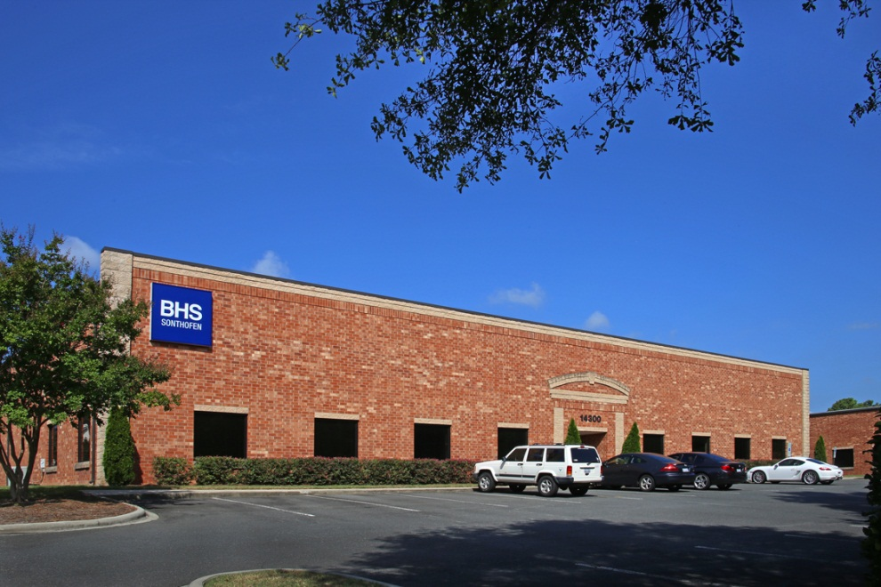
BHS-Filtration New Location
BHS-Sonthofen Inc.: Charlotte, NC
Process Filtration, Drying & Mixing

Slide 3
BHS-Sonthofen Inc.:
Process Technologies
BHS Process Filtration
Batch & Continuous
Pressure & Vacuum
High Solids (50%) to Clarification (<1%)
AVA Process Drying, Mixing & Reacting
Batch & Continuous
Vertical & Horizontal
Bone-Dry Powder
BHS & AVA “Integrated-Continuum” Process Solutions

Slide 4
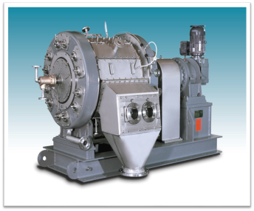
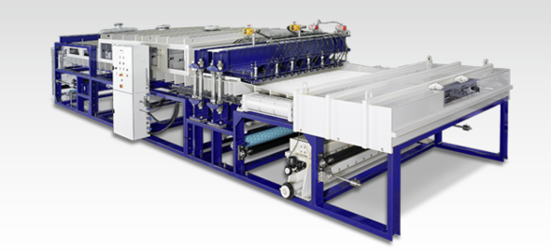
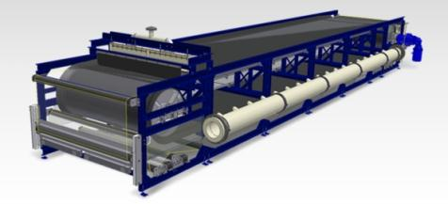
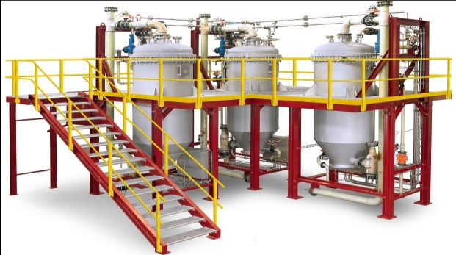
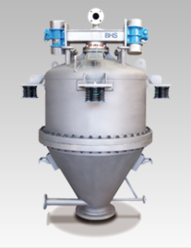
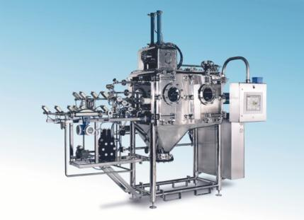
BHS Process Filtration Technology
Rotary Pressure Filter | Continuous-Indexing Belt Filter | Rubber Belt Filter
Candle Filter | Pressure Plate Filter | Autopress

Slide 5
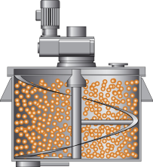
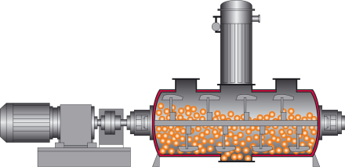
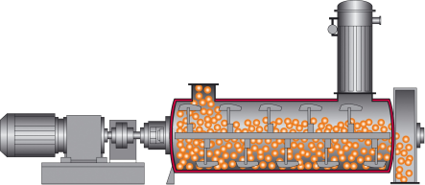
Scope
AVA Mixer & Dryer Technologies
Horizontal
Capacities to 30,000 liters
Vertical
Capacities to 1000 m³/hour
Mixers
Dryers
Design Conditions: FV to 30 bar; -30°C to 700°C

Slide 6
BHS-AVA Mixer & Dryer Applications
Mixing/Homogenizing
Drying/Humidifying
Reacting/Crystallizing
Evaporating/Cooling/Stripping
Sterilizing/Roasting
Granulating

Slide 7
BHS Process Capabilities & Solutions
Process Filtration Design with Lab & On-Site Pilot Testing
Lab Filters in 316 Ti, PP and Tantaline for Corrosive Materials
Drying, Mixing, Reacting Test Center
Special Programs for Long-Term Rentals and Lease-Buy Options

Slide 8
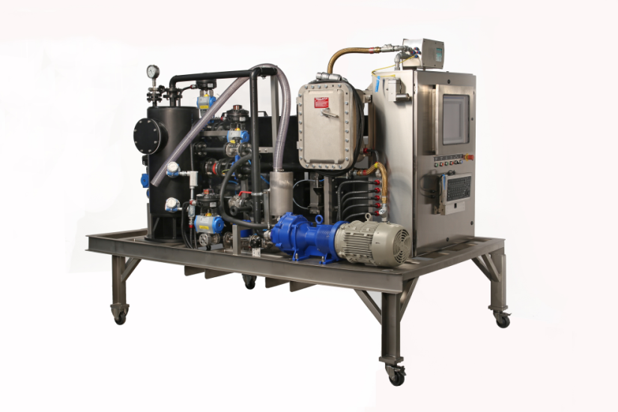
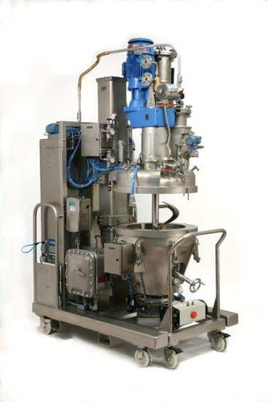
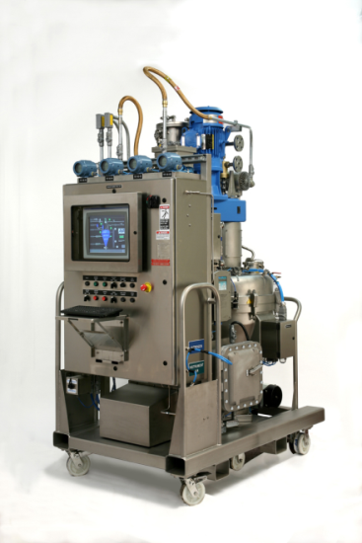
BHS-AVA Small Scale Solutions
0.3 m2 Vacuum Belt Filter
50-liter Multipurpose Dryer-Mixer-Reactor
Rental, Lease-Purchase, Long-Term Production
& Special Requirements-Other Sizes Available

Slide 9
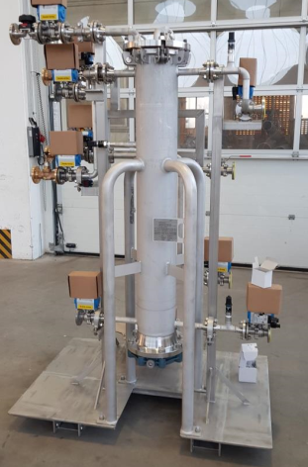
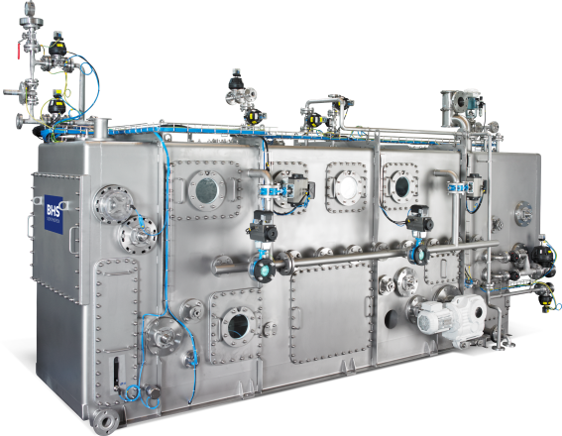
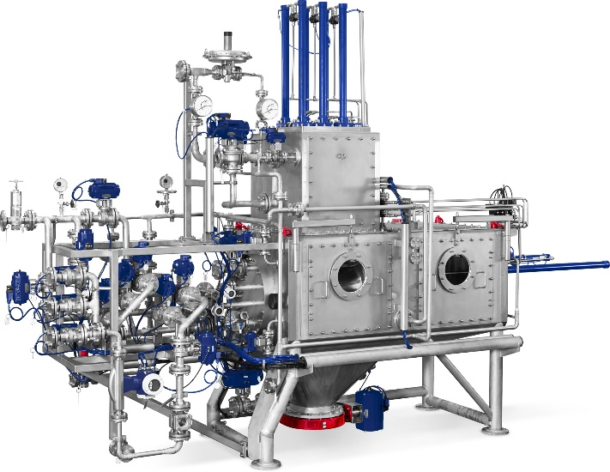
BHS-AVA Small Scale Solutions
Fully Enclosed
Vacuum Belt Filter
Pharma
Candle Filter
AutoPress
Pharma Filter Press

Slide 10
Summary: BHS Process Solutions
Process Design with lab and pilot testing
BHS Process Technologies:
Filtration, Cake Washing & Dewatering
AVA Mixing, Reacting & Drying to “Bone-Dry” Powder
“Integrated-Continuum” Process Solutions
Project & Process Engineering
Complete Turnkey Technology Systems:
PLC Controls, Tanks, Pumps, Piping/Wiring,Structures
Performance Guarantees & Testing
Commissioning, Spare Parts & Service

Slide 11
BHS-Sonthofen Inc.
Barry A. Perlmutter, President & Managing Director
E-mail: barry.perlmutter@bhs-filtration.com
Telephone: (Office) 704.814.7661
BHS Blog: www.perlmutterunfiltered.com
BHS Book: Practical Guides in Chemical Engineering:
Solid-Liquid Filtration
Published by Elsevier
www.bhs-filtration.com

